Slide 1

Entity Profiling with Varying Source Reliabilities
Date: 2015/02/26
Author:Furong Li,Mong Li Lee,Wynne Hsu
Source: KDD ’14
Advisor: Dr. Jia-Ling Koh
Speaker: Sheng Chih Chu

Slide 2

Outline
Introduction
COMET Framework
Experiments
Conclusion

Slide 3

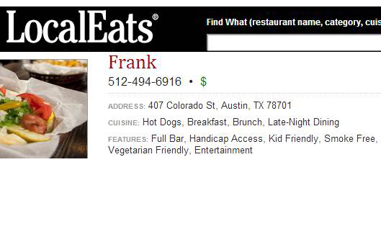
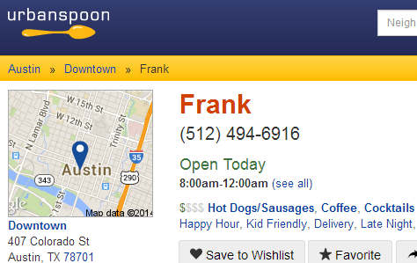
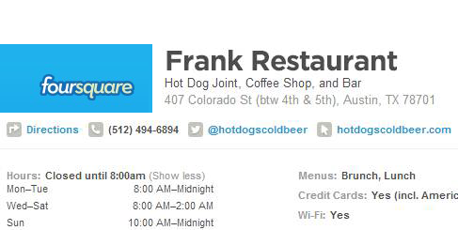
Introduction

Slide 4
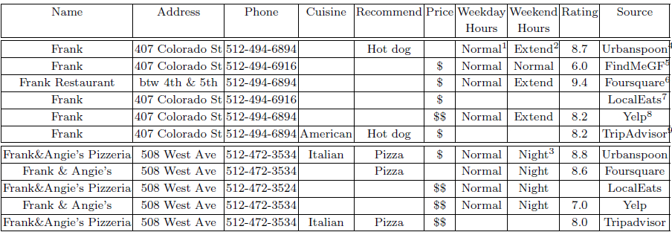
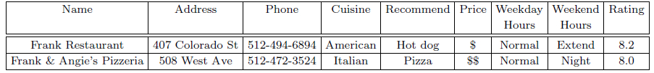
Introduction
Various name representations
Erroneous attribute values
Incomplete information
Ambiguous references
Entity Profiling

Slide 5
Outline
Introduction
COMET Framework
  Confidence Based Matching
  Adaptive Matching
Experiments
Conclusion

Slide 6
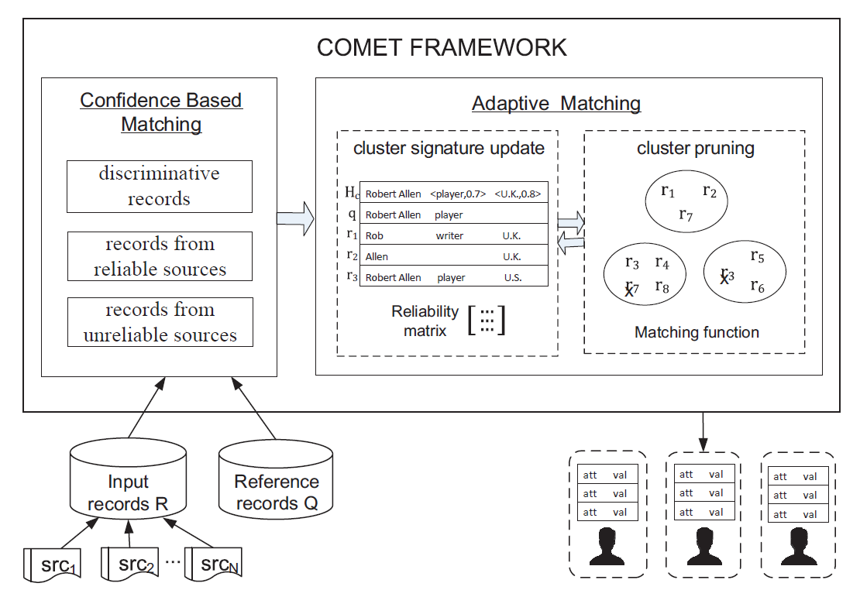
COMET Framework
將records依可靠度分開
initial

Slide 7
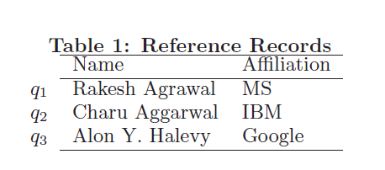
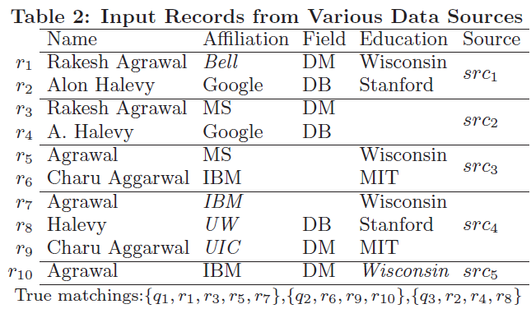
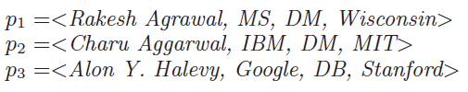
Input Example
x
x

Slide 8
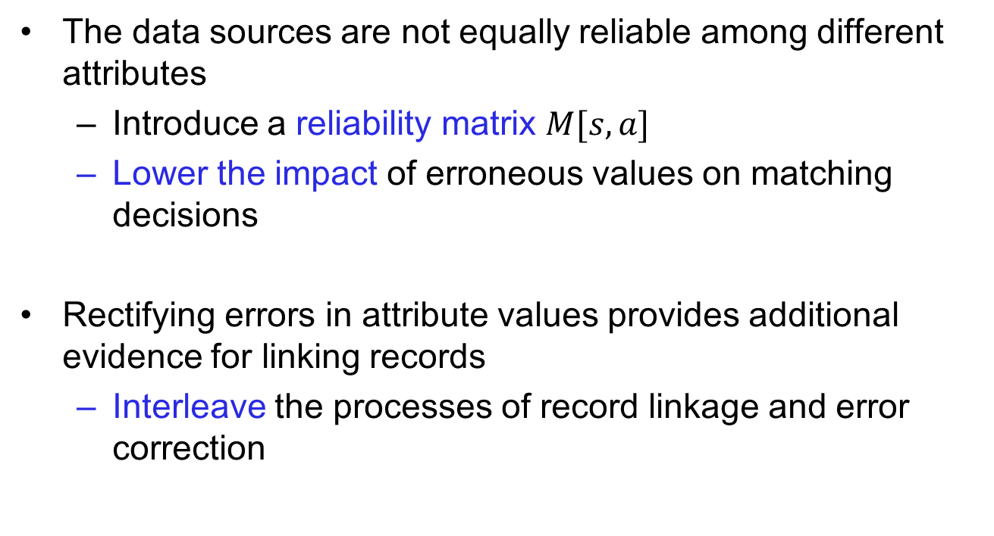
Input Example
The data sources are not equally reliable among different attributes
  Introduce a reliability matrix $M[s,a]$
  Lower the impact of erroneous values on matching decisions
Rectifying errors in attribute values provides additional evidence for linking records
  Interleave the processes of record linkage and error correction

Slide 9


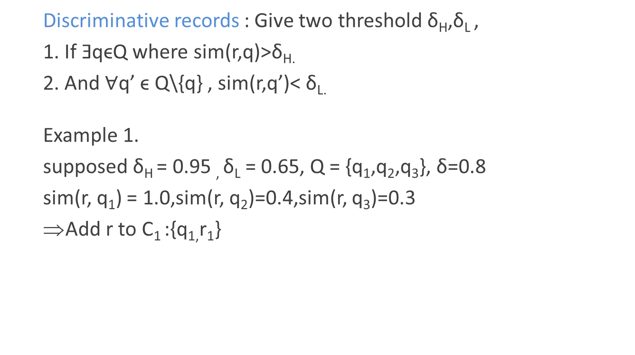
Confidence based Matching
  Discriminative records : Give two threshold δ_{H},δ_{L} ,
  1. If ƎqϵQ where sim(r,q)>δ_{H.}
  2. And$∀$q’ ϵ Q\{q} , sim(r,q’)< δ_{L.}
  Example 1.
  supposed δ_{H} = 0.95 , δ_{L} = 0.65, Q = {q₁,q₂,q₃}, δ=0.8
  sim(r, q₁) = 1.0,sim(r, q₂)=0.4,sim(r, q₃)=0.3
  Add r to C₁ :{q_{1,}r₁}

Slide 10
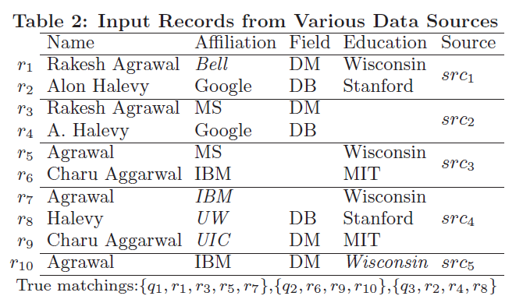
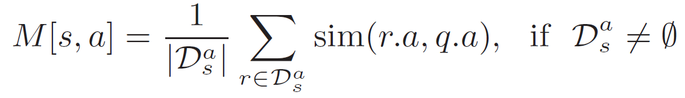
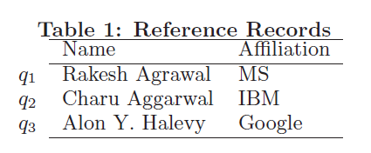
Confidence based Matching
  Define a reliability Matrix M[s,a]:
  s₁.a₁ , s₁.a₂ , s₁.a_{3…}
  …
  s₅.a₁ , s₅.a₂ , s₅.a₃
  Let D_{s} is set of discriminative records publish by s.
Source 1
Source 5
  Supposed confindent match are {(r₁,q₁),(r₃,q₁),(r₆,q₂),(r₉,q₂),(r₂,q₃)}
  D_{s1}:{(r₁,q₁),(r₂,q₃)} , D_{s2}:{(r₃,q₁)} , D_{s3}:{(r₆,q₂)} , D_{s4}:{(r₉,q₂),}

Slide 11
Confidence based Matching
  D_{s1}:{(r₁,q₁),(r₂,q₃)} , D_{s2}:{(r₃,q₁)} , D_{s3}:{(r₆,q₂)} , D_{s4}:{(r₉,q₂),}
  M[s₁,Name]=(sim(“Rakesh Agrawal”, “Rakesh Agrawal”)+sim(“Alon Halevy”,”Alon Y. Halevy”)) / 2 = 1
  M[s₁,Affliation]= (sim(Bell,MS) + sim(Google,Google))/ 2=0.5
  M[s₂, Name] = sim(Rakesh Agrawal, Rakesh Agrawal) / 1 = 1.0
  M[s₂, Affliation]=sim(MS,MS) / 1 =1.0
  M[s₃, Name] = sim(Charu Aggarwal, Charu Aggarwal) / 1 =1.0
  M[s₃, Affliation] = sim(IBM,IBM) / 1 =1.0
  M[s₄, Name] = sim(Charu Aggarwal, Charu Aggarwal) / 1 = 1.0
  M[s₄, Affliation] = sim(UIC,IBM) / 1 = 0.2
null null
null null
null null
null null
null null
M =
1.0 0.5
1.0 1.0
1.0 1.0
1.0 0.2
null null
ε = 0.001
0.375
0.5
0.5
0.3
0

Slide 12
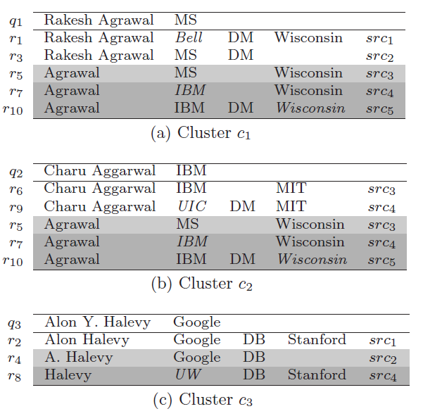
Confidence based Matching
Reliable and unreliable source
µ and σ is the mean and standard deviation of X
0.375
0.5
0.5
0.3
0
Discriminative record
Reilable:{s₁,s₂,s₃}
{r₄,r₅}
unreliable{s₄,s₅}
{r₇.r₈,r₁₀}

Slide 13
Adaptive Matching
Input Reliability matrix M and Clusters C
a) compute the cluster signatures.
b) update the reliability matrix
c) refine the clusters

Slide 14

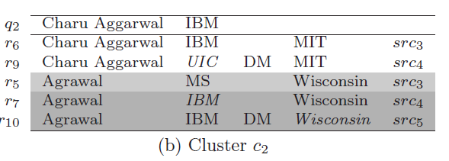

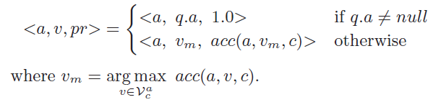
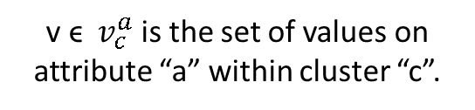
Adaptive Matching
Initial
v ϵ $v_{c}^{a}$ is the set of values on attribute “a” within cluster “c”.
Example : Education : “MIT” , ”Wisconsin” in cluster 2
Supposed L(r₅,c₂) = L(r₁₀,c₂) = L(r₇,c₂) = 0.5 ,M=[0.8…]
acc(Education , MIT,c₂) =L(r₆,Education)*M[s₃,Education]+ L(r₉,Education) *M[s₄,Education] = 1*0.8+1*0.8 = 1.6
acc(Education , Wisconsin ,c₂)=L(r₅,Education)*M[s₃,Education]+L(r₇,Education)* M[s₄,Education]+L(r₁₀, Education)*M[s₅,Eucation] =0.5*0.8+0.5*0.8+0.5*0.8=1.2
build H_{c2} = <Education, “MIT” ,0.6>

Slide 15

Adaptive Matching
Update Matrix
Example: M[s₄,Afflication]? R_{s}:{r₇,r₈,r₉} r₇:{c₁,c₂} r₈:{c₃} r₉:{c₂}
Supposed acc(Afflication,”IBM”,c₁) = 0.4 and acc(Afflication,”IBM”,c₂) = 0.6
M[s₄,Afflication] = {[L(r₇,c₁)* acc(Afflication,”IBM”,c₁) + L(r₇,c₂)* acc(Afflication,”IBM”,c₂)] +[L(r₈,c₃)*acc(Afflication,”UW”,c₃)]+[L(r₉,c₂)* acc(Afflication,”UIC”,c₂)]}/3 = 0.33

Slide 16
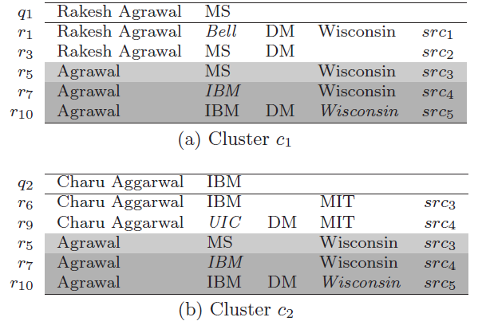
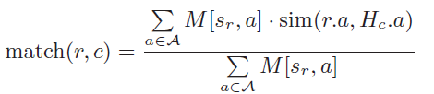
Adaptive Matching
Cluster pruning
Example: consider r₇ , M[s₄,Afflication] = 0.33, M[s₄,Education] = 0.8
H_{c1}:<Affiliation,”MS”,1.0>,<Education,”Wisconsin”,1.0>
H_{c2}:<Affiliation,”IBM”,1.0>,<Education,”MIT”,0.6>
Match(r₇,c₁)= [M[s₄,Affiliation] * sim(“IBM”,”MS”)+ M[s₄,Education] * sim(“Wisconsin”,” Wisconsin”) ]/ (M[s₄,Affiliation] + M[s₄,Education])
Match(r₇,c₂)=[M[s₄,Affiliation] * sim(“IBM”,”IBM”)+ M[s₄,Education] * sim(“Wisconsin”,”MIT”) ]/ (M[s₄,Affiliation] + M[s₄,Education])
Remove r₇ in cluster 2

Slide 17

Adaptive Matching
Update likelihood L(r,c)
Example: r₁₁:{c₁,c₂,c₃,c₄} ,if remove r₁₁ in c₃
L(r₁₁,c₁) = match(r₁₁,c₁) / [match(r₁₁,c₁) +match(r₁₁,c₂)+match(r₁₁,c₄)]
L(r₁₁,c₂) = match(r₁₁,c₂) / [match(r₁₁,c₁)+ match(r₁₁,c₂) +match(r₁₁,c₄)]
L(r₁₁,c₄) = match(r₁₁,c₄) / [match(r₁₁,c₁)+match(r₁₁,c₂)+ match(r₁₁,c₄)]
Repeat above step util there is no change to the C.

Slide 18
Outline
Introduction
COMET Framework
Experiments
Conclusion

Slide 19
Experiments
Dataset
Restaurant dataset :
  Records 1082 , 384 restaurants(581),18.7 % error rate,
  Attribute Name,Address,Phone,Website,etc.
  Reference table Name , Phone.(from www.yellowpages.com)
Football dataset
  Records 7492,20 website(5031),32.7% error rate
  Attribute Name,Birth.,Height,Weight,Position,BirthPlace
  Reference table Name,Birth.,BirthPlace (from wiki)

Slide 20
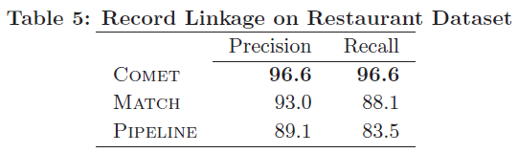
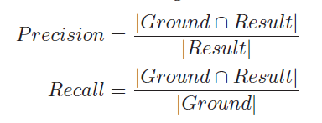
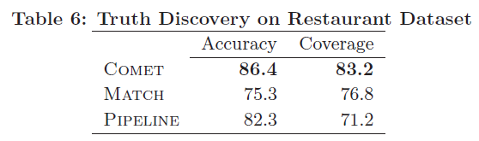
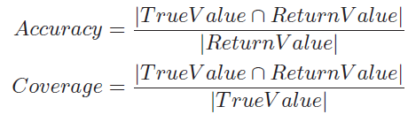
Experiments

Slide 21
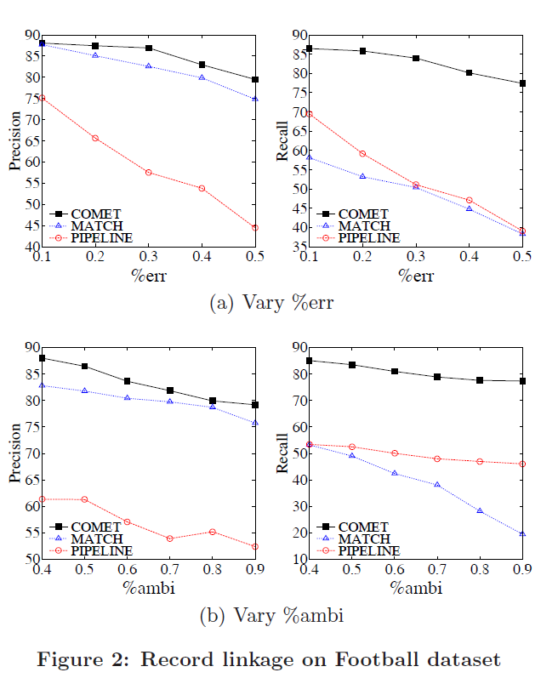
%err: percentage of erroneous values
%ambi: percentage of records with abbreviated names

Slide 22
Outline
Introduction
COMET Framework
Experiments
Conclusion

Slide 23

Conclusion
Address the problem of building entity profiles by collating data records from multiple sources in the presence of erroneous values
Interleave record linkage with truth discovery
Varying source reliabilities
Reduce the impact of erroneous values on matching decisions

